Slide 1

Advanced Analytics— Technology and Tools: In-Database Analytics
Author : FU
Date : Mar-2022

Slide 2
Objectives
After studying this chapter, the student should be able to the key conceptss:
MADlib
Regular expressions
SQL
User-defined functions
Window functions

Slide 3
Content
1. SQL Essentials
2. In-Database Text Analysis
3 Advanced SQL

Slide 4
1. SQL Essentials
Figure 11-1 shows the relationships between five tables used to store details about orders placed at an e-commerce retailer.
Table orders contains records for each order transaction. Each record contains data elements such as the product_id ordered, the customer_id for the customer who placed the order, the order_datetime, and so on.
FIGURE 11-1 Relationship diagram

Slide 5
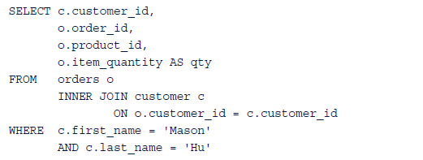
Joins 1/3
Joins enable a database user to appropriately select columns from two or more tables.
For example

Slide 6
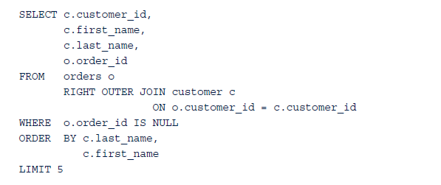
Joins 2/3
In the SQL query, a RIGHT OUTER JOIN is used to specify that all rows from the table customer, on the right-hand side (RHS) of the join, should be returned

Slide 7
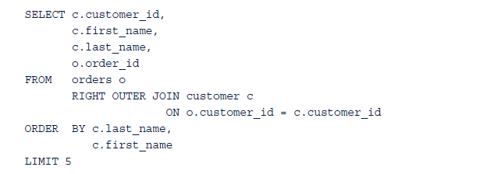
Joins 3/3
LEFT OUTER JOIN performs the same functionality as the RIGHT OUTER JOIN except that all records from the table on the left-hand side (LHS) of the join are considered.
A FULL OUTER JOIN includes all records from both tables regardless of whether there is a matching record in the other table.
A CROSS JOIN combines two tables by matching every row of the first table with every row of the second table. If the two tables have 100 and 1,000 rows, respectively, then the resulting CROSS JOIN of these tables will have 100,000 rows.

Slide 8
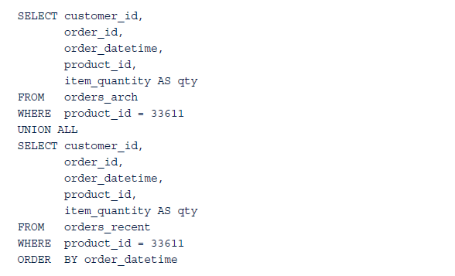
Set Operations 1/2
UNION ALL operator as follows:
UNION ALL merges the results of the two SELECT statements regardless of any duplicate records appearing in both SELECT statements. If only UNION was used, any duplicate records, based on all the specified columns, would be eliminated.

Slide 9
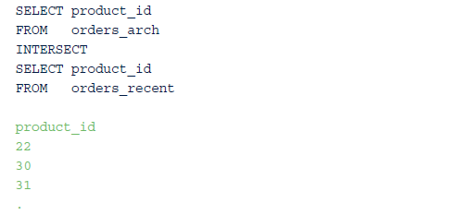
Set Operations 2/2
INTERSECT operator determines any identical records that are returned by two SELECT statements.
For example, if one wanted to know what items were purchased prior to 2013 as well as later, the SQL query using the INTERSECT operator would be this.

Slide 10
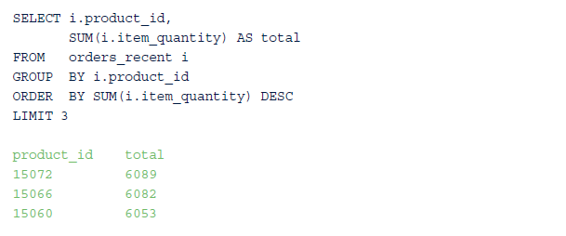
Grouping Extensions 1/3
COUNT() aggregate function was used to count the number of returned rows from a query. Such aggregate functions often summarize a dataset after applying some grouping operation to it.
For example, it may be desired to know the revenue by year or shipments per week. The following SQL query uses the SUM() aggregate function along with the GROUP BY operator to provide the top three ordered items based on item_quantity.

Slide 11
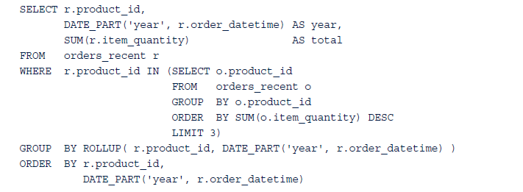
Grouping Extensions 2/3
GROUP BY can use the ROLLUP() operator to calculate subtotals and grand totals.
The following SQL query employs the previous query as a subquery in the WHERE clause to supply the number of items ordered by year for the top three items ordered overall.
ROLLUP operator provides the subtotals, which match the previous output for each product_id, as well as the grand total.

Slide 12
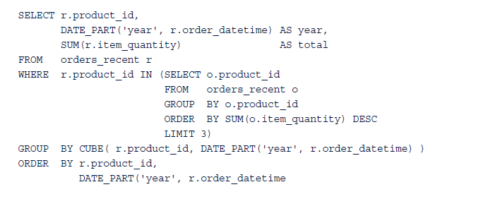
Grouping Extensions 3/3
CUBE operator expands on the functionality of the ROLLUP operator by providing subtotals for each column specified in the CUBE statement.
Modifying the prior query by replacing the ROLLUP operator with the CUBE operator results in the same output with the addition of the subtotals for each year.

Slide 13
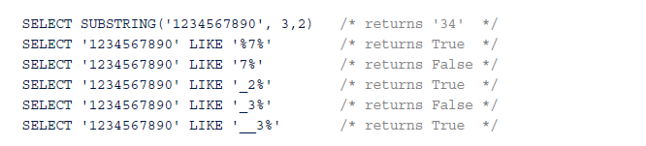
2 In-Database Text Analysis 1/5
SQL offers several basic text string functions as well as wildcard search functionality.
Related SELECT statements and their results enclosed in the SQL comment delimiters, /**/, include the following:
regular expressions: dynamic and flexible tools for text analysis. their use in SQL queries to perform pattern matching. Table 11-1 includes several forms of the comparison
operator used with regular expressions and related SQL examples that produce a True result.

Slide 14
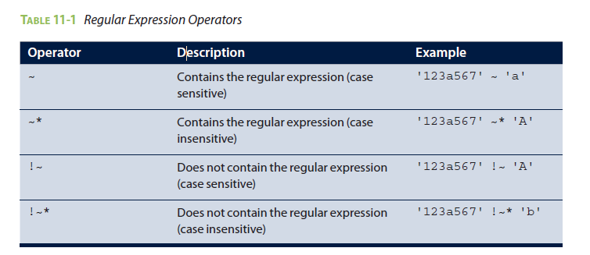
In-Database Text Analysis 2/5

Slide 15
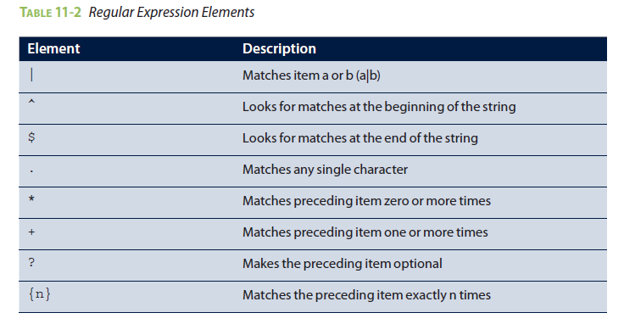
In-Database Text Analysis 3/5
More complex forms of the patterns that are specified at the RHS of the comparison operator can be constructed by using the elements in Table 11-2.

Slide 16
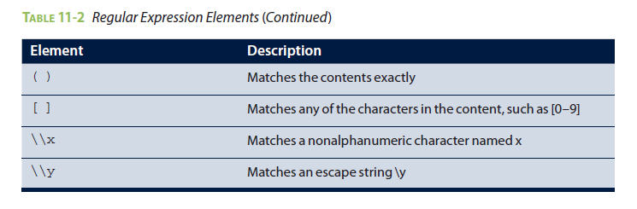
In-Database Text Analysis 4/5
The following SELECT statements include examples in which the comparisons are True or False.

Slide 17
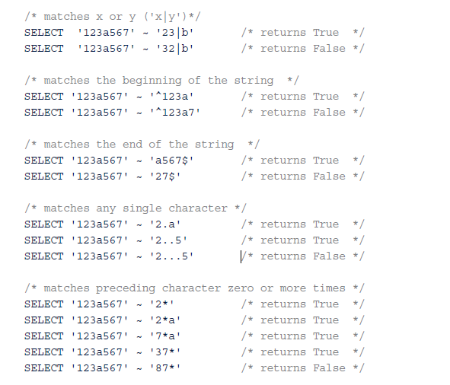
In-Database Text Analysis 5/5

Slide 18
3 Advanced SQL
Building upon the foundation provided in the earlier parts of this chapter, this section presents advanced SQL techniques that can simplify in-database analytics.

Slide 19
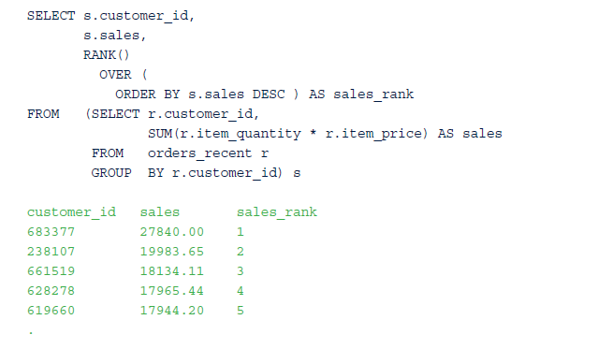
3.1 Window Functions 1/5
A window function enables aggregation to occur but still provides the entire dataset with the summary results.
For example, the RANK() function can be used to order a set of rows based on some attribute. Based on the SQL table, orders_recent, introduced in Section 11.1.2, the following SQL query provides a ranking of customers based on their total expenditures

Slide 20

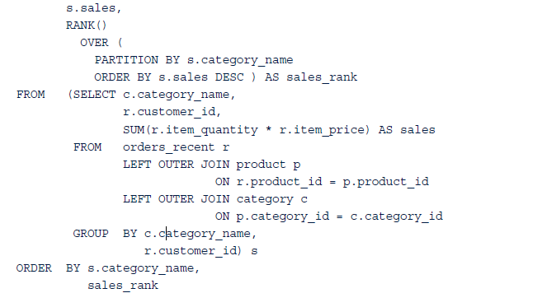
Window Functions 2/5
Subquery in the FROM clause computes the total sales for each customer.
In the outermost SELECT clause, the sales are ranked in descending order. Window functions, such as RANK(), are followed by an OVER clause that specifies how the function should be applied.
Additionally, the window function can be applied to groupings of a given dataset using the PARTITION BY clause. The following SQL query provides the customer rankings based on sales within product categories.

Slide 21
Window Functions 3/5
Windowing functions is used to perform calculations over a sliding window in time.
For example, moving averages can be used to smooth weekly sales figures that may exhibit large week-to-week variation, as shown in the plot in Figure 11-2.
FIGURE 11-2 Weekly sales for an online retailer

Slide 22
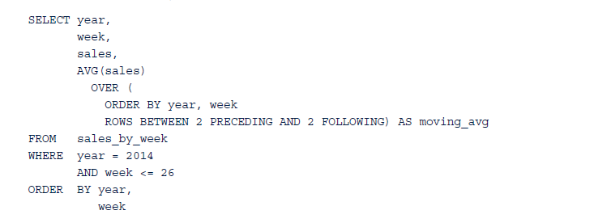
Window Functions 4/5
Windowing function uses the built-in aggregate function AVG(), which computes the arithmetic average of a set of values.
ORDER BY clause sorts the records in chronological order and specifies which rows should be included in the averaging process with the current row. In this SQL query, the moving average is based on the current row, the preceding two rows, and the following two rows

Slide 23
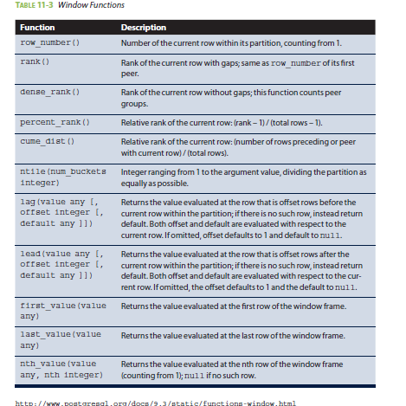
Window Functions 5/5
Built-in window functions may vary by SQL implementation. Table 11-3 from the PostgreSQL documentation includes the list of general-purpose window functions.

Slide 24
3.2 User-Defined Functions and Aggregates 1/6
When the built-in SQL functions are insufficient for a particular task or analysis, SQL enables the user to create user-defined functions and aggregates. This custom functionality can be incorporated into SQL queries in the same ways that the built-in functions and aggregates are used. User-defined functions can also be created to simplify processing tasks that a user may commonly encounter.
For example, a user-defined function can be written to translate text strings for female (F) and male (M) to 0 and 1, respectively. Such a function may be helpful when formatting data for use in a regression analysis. Such a function, fm_convert(), could be implemented as follows:

Slide 25
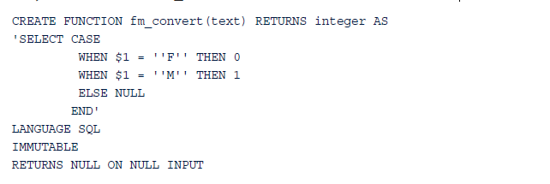
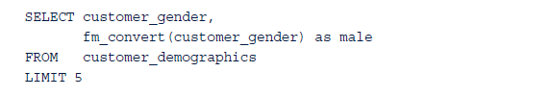
User-Defined Functions and Aggregates 2/6
In declaring the function, SQL query is placed within single quotes. The first and only passed value is referenced by $1. SQL query is followed by a LANGUAGE statement that explicitly states that the preceding statement is written in SQL. Another option is to write the code in C. IMMUTABLE indicates that the function does not update the database and does not use the database for lookups. The IMMUTABLE declaration informs the database’s query optimizer how best to implement the function. The RETURNS NULL ON NULL INPUT statement specifies how the function addresses the case when any of the inputs are null values.
In the online retail example, the fm_convert() function can be applied to the customer_gender column in the customer_demographics table as follows.

Slide 26
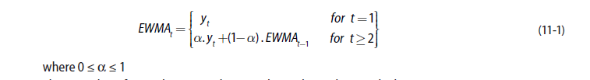
User-Defined Functions and Aggregates 3/6
Built-in and user-defined functions can be incorporated into user-defined aggregates, which can then be used as a window function. In Section 11.3.1, a window function is used to calculate moving averages to smooth a data series. In this section, a user-defined aggregate is created to calculate an Exponentially Weighted Moving Average (EWMA). For a given time series, the EWMA series is defined as shown in Equation 11-1.
To implement EWMA smoothing as a user-defined aggregate in SQL, the functionality in Equation 11-1
needs to be implemented first as a user-defined function.

Slide 27
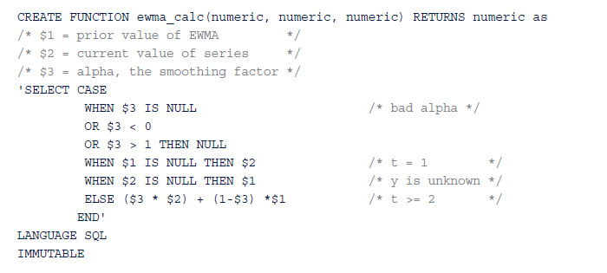
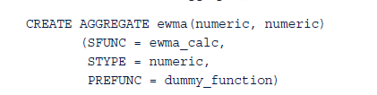
User-Defined Functions and Aggregates 4/6
Accepting three numeric inputs as defined in the comments, the ewma_calc() function addresses possible bad values of the smoothing factor as well as the special case in which the other inputs are null. The ELSE statement performs the usual EWMA calculation. Once this function is created, it can be referenced in the user-defined aggregate, ewma()

Slide 28
User-Defined Functions and Aggregates 5/6
In the CREATE AGGREGATE statement for ewma(), SFUNC assigns the state transition function (ewma_calc in this example) and STYPE assigns the data type of the variable to store the current state of the aggregate.
The variable for the current state is made available to the ewma_calc() function as the first variable, $1.
In this case, because the ewma_calc() function requires three inputs, the ewma() aggregate requires only two inputs; the state variable is always internally available to the aggregate.
The PREFUNC assignment is required in the Greenplum database for use in a massively parallel processing (MPP) environment. For some aggregates, it is necessary to perform some preliminary functionality on the current state variables for a couple of servers in the MPP environment.
In this example, the assigned PREFUNC function is added as a placeholder and is not utilized in the proper execution of the ewma() aggregate function.

Slide 29
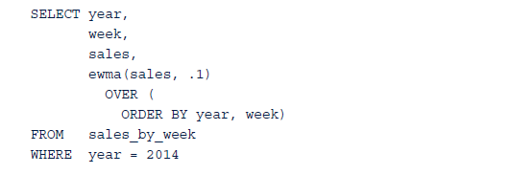

User-Defined Functions and Aggregates 6/6
ewma() aggregate, with a smoothing factor of 0.1, can be applied to the weekly sales data as follows.
Figure 11-4 includes the EWMA smoothed series to the plot from Figure 11-3.
FIGURE 11-4 Weekly sales with moving average and EWMA

Slide 30
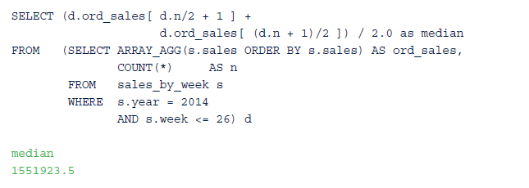
3.3 Ordered Aggregates 1/3
Sometimes the value of an aggregate may depend on an ordered set of values. For example, to determine the median of a set of values, it is common to first sort the values from smallest to largest and identify the median from the center of the sorted values.
array_agg() function used to sort data. The following SQL query calculates the median of the weekly sales data.

Slide 31
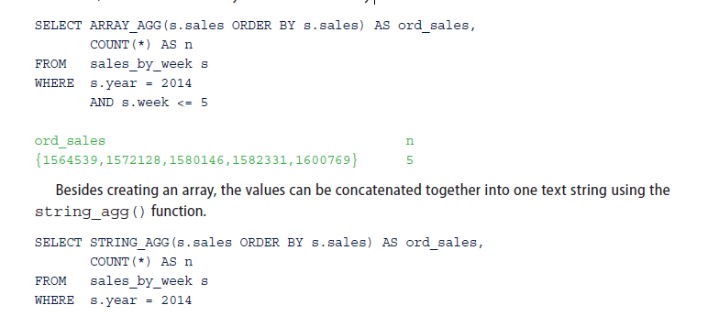
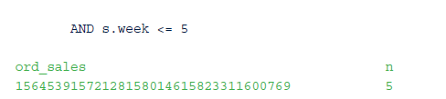
Ordered Aggregates 2/3
ARRAY_AGG() builds an array from a table column. Executing the subquery from the previous SQL query for just the first five weeks illustrates the creation of the array, denoted by the braces, and the sorted weekly sales within the array.

Slide 32
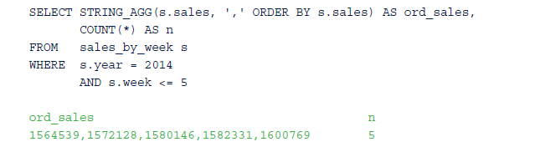
Ordered Aggregates 3/3
However, in this particular example, it may be useful to separate the values with a delimiter, such as a comma.

Slide 33
3.4 MADlib 1/6
MADlib is an open-source library for scalable in-database analytics. It offers data-parallel implementations of mathematical, statistical, and machine learning methods for structured and unstructured data
Concept of Magnetic/Agile/Deep (MAD) analysis skills was introduced in a 2009 paper by Cohen, et al.. This paper describes the components of MAD as follows:
Magnetic
Agile
Deep

Slide 34
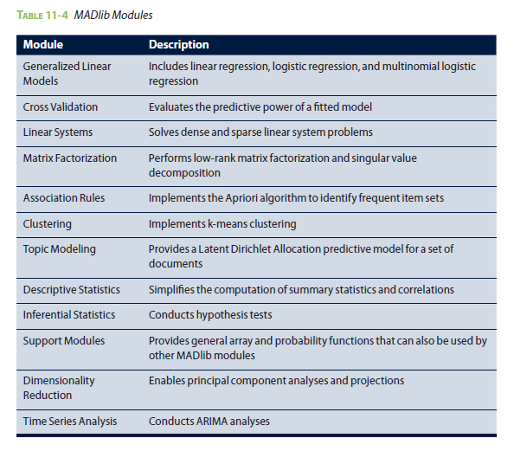
MADlib 2/6

Slide 35
MADlib 3/6
In the following example, MADlib is used to perform a k-means clustering analysis on the web retailer’s customers.
Two customer attributes—age and total sales since 2013—have been identified as variables of interest for the purposes of the clustering analysis.
The customer’s age is available in the customer_demographics table. The total sales for each customer can be computed from the orders_recent table.
Because it was decided to include customers who had not purchased anything, a LEFT OUTER JOIN is used to include all customers. The customer’s age and sales are stored in an array in the cust_age_sales table. The MADlib k-means function expects the coordinates to be expressed as an array.

Slide 36
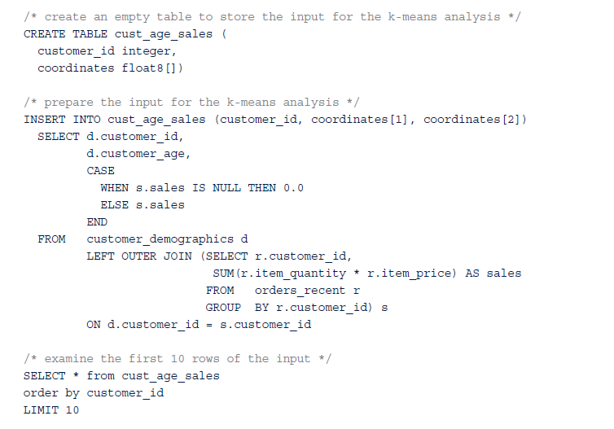
MADlib 4/6

Slide 37
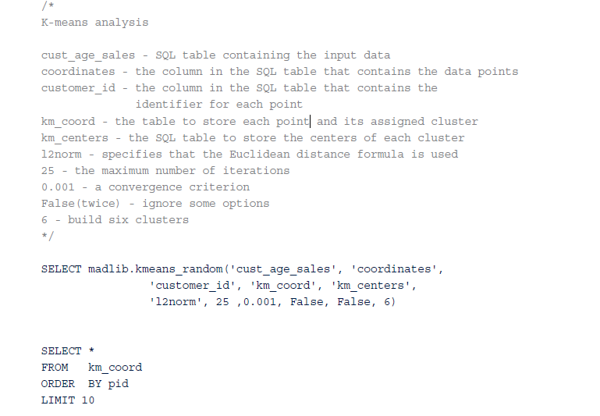
MADlib 5/6
Using the MADlib function, kmeans_random(), the following SQL query identifies six clusters within the provided dataset. A description of the key input values is provided with the query.

Slide 38
MADlib 6/6
Output consists of the km_coord table. This table contains the coordinates for each point id (pid), the customer_id, and the assigned cluster ID (cid).
The coordinates (coords) are stored as sparse vectors. Sparse vectors are useful when values in an array are repeated many times. For example, {1,200,3}:{1,0,1} represents the following vector containing 204 elements, {1,0,0,…0,1,1,1}, where the zeroes are repeated 200 times.
The coordinates for each cluster center or centroid are stored in the SQL table km_center.
SELECT * FROM km_centers ORDER BY coords

Slide 39
Summary
Illustrating how SQL can be used to perform in database analytics.
A typical SQL query involves joining several tables, filtering the returned dataset to the desired records with a WHERE clause, and specifying the particular columns of interest.
SQL provides the set operations of UNION and UNION ALL to merge the results of two or more SELECT statements or INTERSECT to find common record elements.
Other SQL queries can summarize a dataset using aggregate functions such as COUNT() and SUM() and the GROUP BY clause.
Grouping extensions such as the CUBE and ROLLUP operators enable the computation of subtotals and grand totals
Regular expressions and related functions can be used in SQL to examine and restructure such unstructured data for further analysis.
More complex SQL queries can utilize window functions to supply computed values such as ranks and rolling averages along with an original dataset. In addition to built-in functions, SQL offers the ability to create user-defined functions
Although it is possible to process the data within a database and extract the results into an analytical tool such as R, external libraries such as MADlib can be utilized by SQL to conduct statistical analyses within a database.

